Slide 1
CRM Analytics
Team Members
Vikas Mahadeva
Sakshi Balkrishna Jadhav
Mayur Kanth
Avadhesh Dindayal Yadav

Slide 2
Overview
This project involves analyzing Salesforce CRM data to gain insights into lead generation, conversions, and opportunity management. The goal is to enable data-driven decisions for improving sales performance.
Objective of the Analysis :
Understand lead and opportunity trends
Identify top-performing sources and industries
Track conversion rates and revenue potential
Analyze performance over time
Tools/Technologies Used:
Excel , Tableau ,Power BI and My SQL: Dashboard creation
Salesforce CRM: Data source
Logical Functions ,Filters ,Pivot table ,calculation field ,DAX & Power Query: Data modeling and transformation

Slide 3
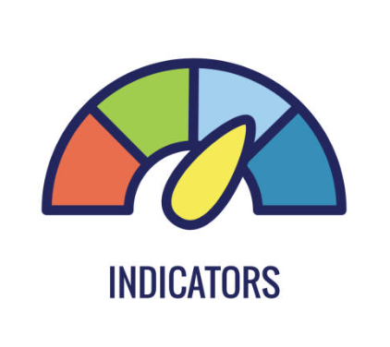
Key Performance Indicators (KPIs)
Leads Analysis KPIs:
Total Leads: 10K
Expected Amount: $38.92M
Converted Accounts: 1,016
Converted Opportunities: 411
Lead Conversion Rate: 10.33%
Opportunity Analysis KPIs :
Total Expected Amount: $184.14M
Active Opportunities: 1,272
Win Rate: 31.06%
Opportunity Conversion Rate: 27.38%
Loss Rate: $ 838.37M
Trend Analysis:
Running Total Expected Vs Commit Forecast Amount over Time
Running Total Active Vs Total Opportunities over Time
Closed Won Vs Total Opportunities over Time
Closed Won vs Total Closed over Time

Slide 4
We had Total 10k Leads out of which only 411 converted to Opportunities at the conversion Rate 10.33%.
Highest Count of Leads by Lead Source came out to be 2786 to the Lead Source named "Inside Sales".
Highest Count of Leads by Industry is 5357 which belongs to the industry "Safety and Security".
Count of Total Active Opportunities is 1272.
Win Rate at which the sales team measures the success rate of sales team in converting an Opportunity into a sale came out to be: 31.06% while Opportunity Conversion rate is 27.38%.
Highest Count of Opportunities is 1143 for Biopharma/Pharmaceuticals Industry while highest Expected amount is 4.21M for Safety and Security Opportunity type.
Total opportunities v/s closed won opportunities is increasing till 2020 and suddenly decreases in 2021 having the final values 711 and 241.

Slide 5

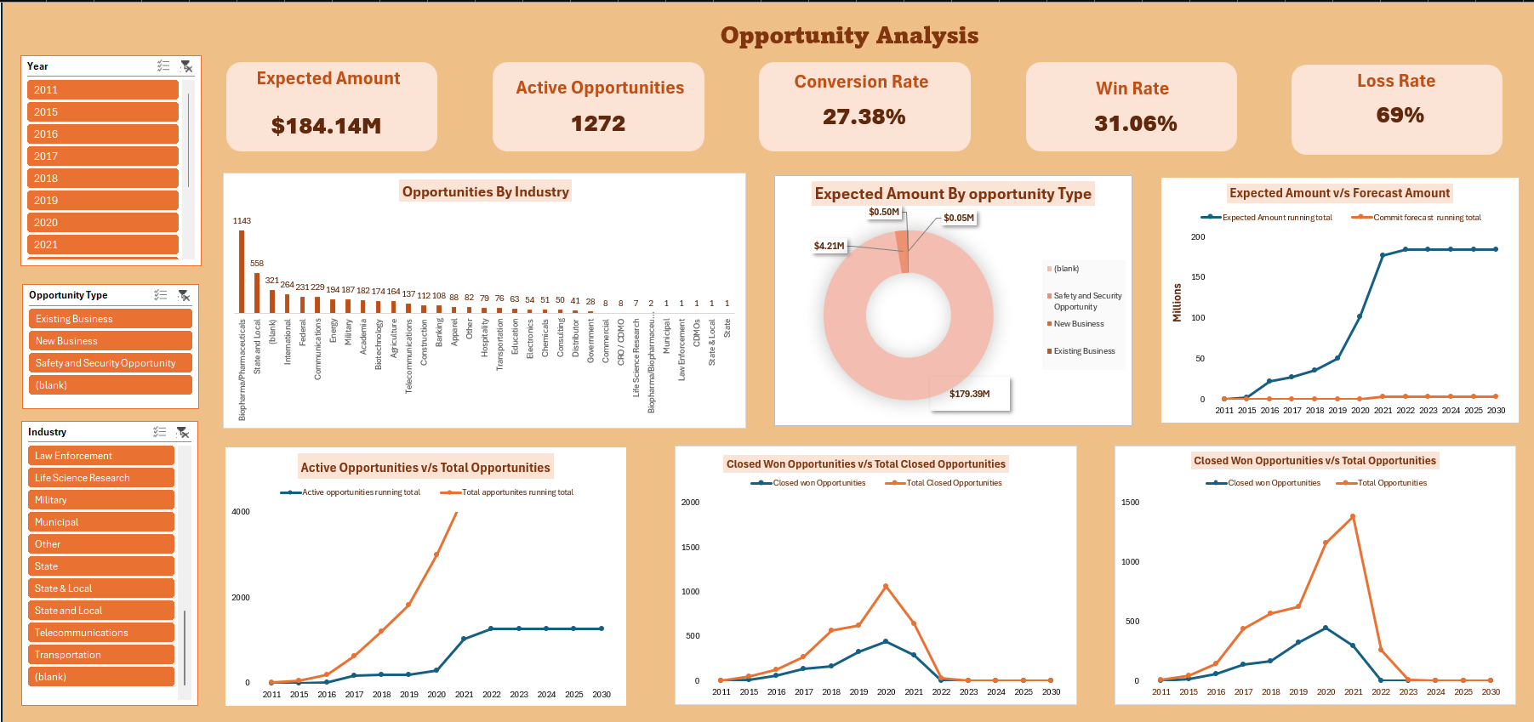
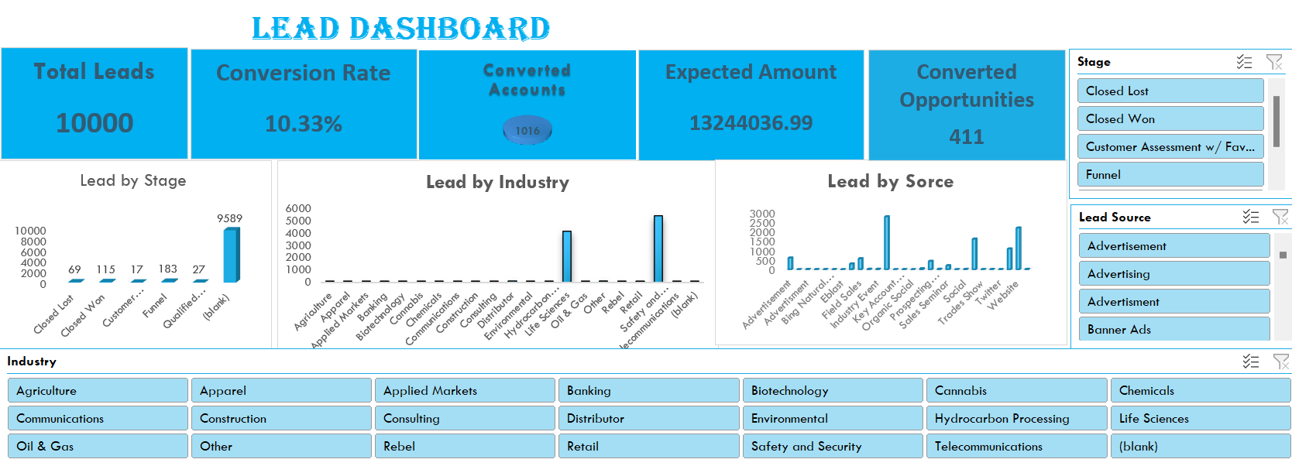
Excel
Dashboards
This Excel dashboard Visualizes key CRM metrics like total leads, conversions, and expected revenue.
Interactive charts and slicers allow filtering by industry, lead source, and status.
Supports quick performance analysis using pivot tables and trend visuals.

Slide 6

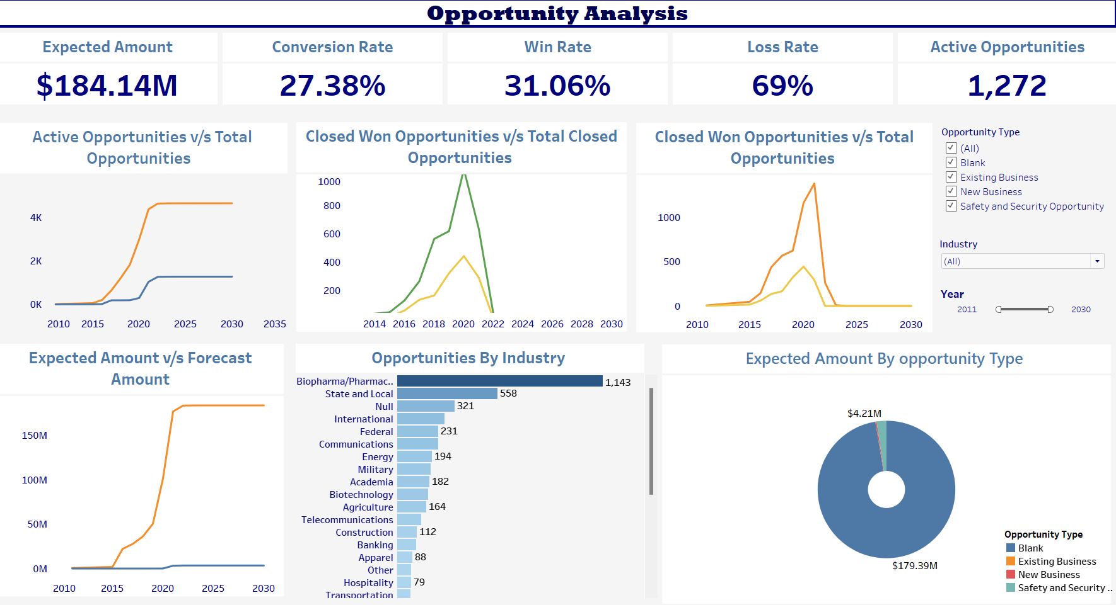
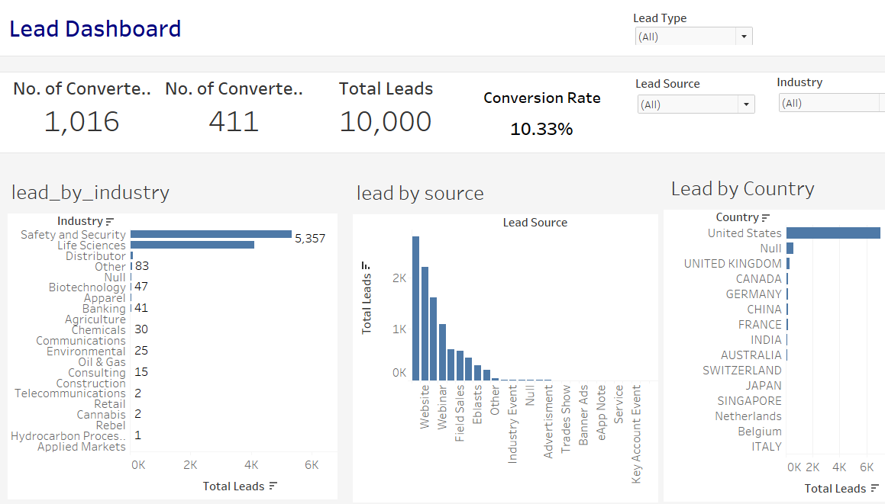
Dashboards
Interactive visualizations display CRM data like leads, opportunities, and conversion rates.
Allows filtering by year, industry, lead source, and opportunity type for in-depth analysis.
Tracks sales performance metrics such as win rate, expected revenue, and lead status.
Enables real-time insights to support strategic sales and Marketing decisions.

Slide 7

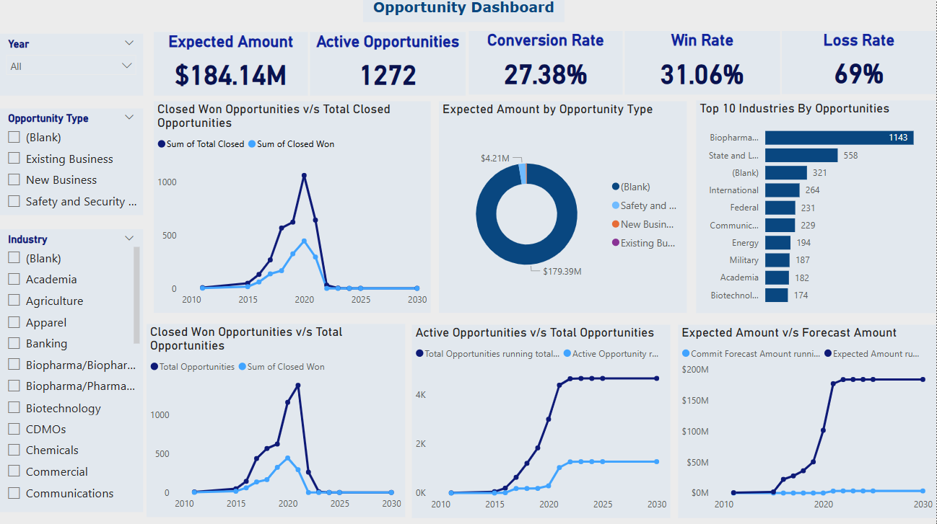
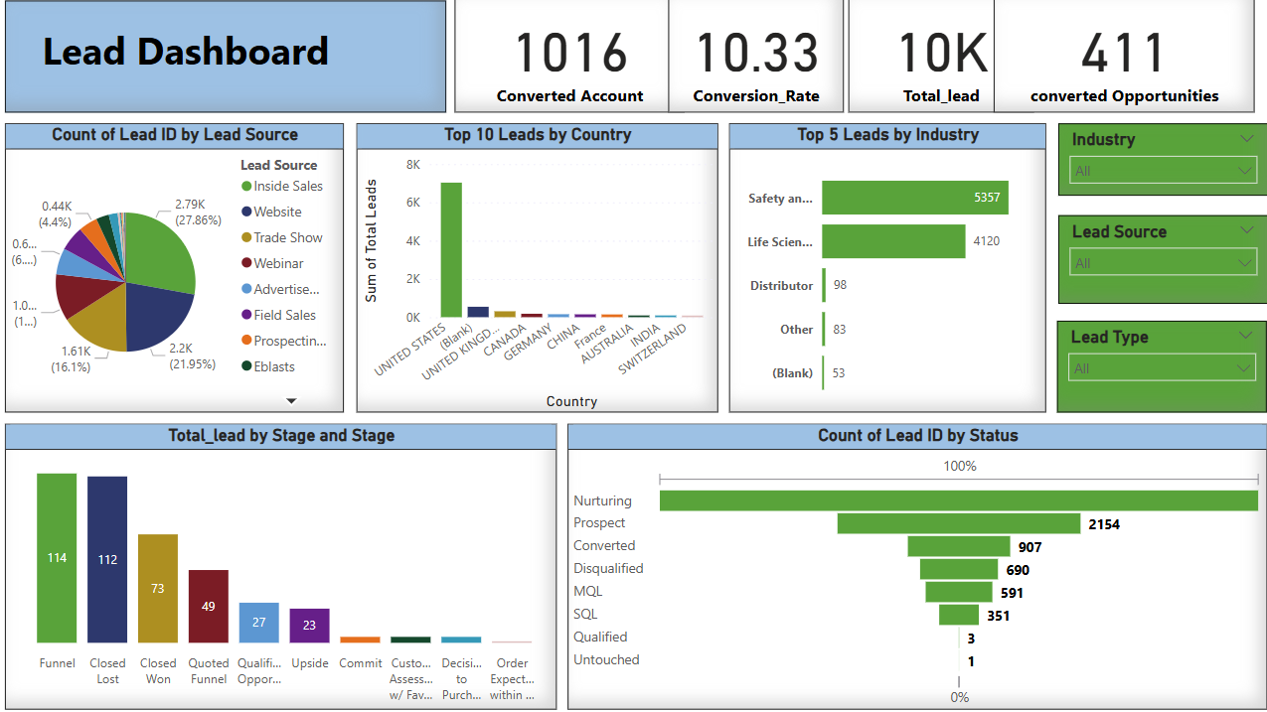
Dashboards
The Power BI dashboards offer a comprehensive overview of leads and opportunities, visualizing key performance indicators like conversion rate, win rate, and expected revenue.
It helps identify top-performing industries, lead sources, and countries, along with tracking lead status and opportunity pipeline trends over time.
Filters by industry, year, opportunity type, and stage enable users to perform targeted, data-driven analysis for better sales and marketing decisions.

Slide 8

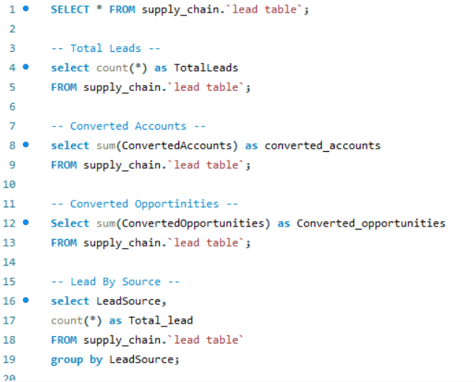
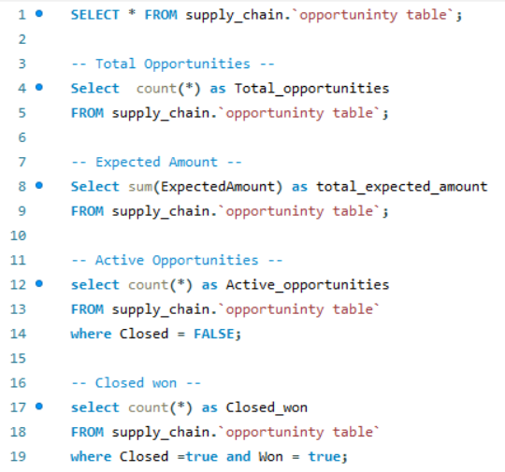
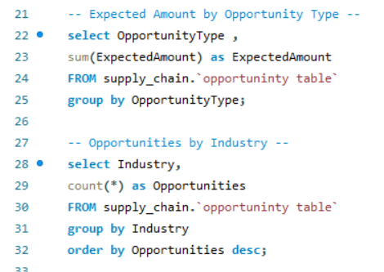
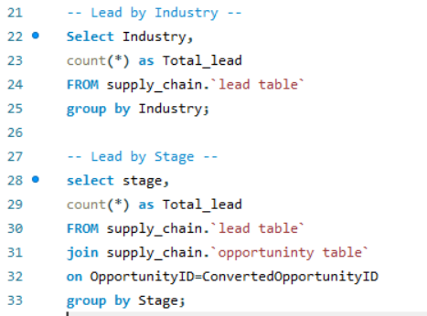
SQL Queries
Queries are designed to fetch various metrics from the `supply_chain` database, specifically from `opportunity` and `lead` tables.
The use of SQL functionalities such as `GROUP BY` and aggregation functions (like `SUM` and `COUNT`) enables structured insights into the data for decision-making.
These SQL queries extract key business metrics such as total opportunities, expected revenue, and win/loss rates from the opportunity dataset .Grouped queries enable analysis by opportunity type and industry, supporting performance segmentation.
Queries analyze leads through total count, segmentation by source, industry, and stage, helping in understanding lead performance.

Slide 9

Unified CRM Insights: Centralized dashboards to track leads, opportunities, and conversions.
Data-Driven Decisions: Key KPIs support strategic planning and performance monitoring.
Multi-Tool Integration: Built using Power BI, Excel, SQL, and Tableau for flexible reporting.
Interactive Visuals: Dynamic filters enable real-time, customized data exploration.
Thank you

